Slide 1
Constrained Policy Optimization
07/17/24
Euiseok Han

Slide 2
Constrained Policy Optimization
CPO = trust region method + gradient ??

Slide 3





Markov Decision Process
: probability of transition to state s’ given that
previous state s
agent took action a in s
: stationary policy,
Map from states to probability distributions over action
: performance measure,
select policy π s.t. maximize J(π)
$$a_{t} \sim π\left(⋅ | s_{t}\right)$$
a0
a1
s2
a2
$$a_{t+1} \sim P\left(⋅ | s_{t}, a_{t}\right)$$
s0~µ
s1
s3
$V^{π}\left(s\right)≐E_{τ\sim π}[R(τ)|s_{0}=s]$ : On-policy value function
$Q^{π}\left(s, a\right)≐E_{τ\sim π}[R(τ)|s_{0}=s, a_{0}=a]$ : on-policy action-value function
$A^{π}\left(s, a\right)≐Q^{π}\left(s, a\right)−V^{π}(s)$ : advantage function

Slide 4
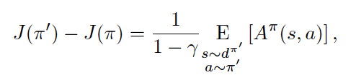


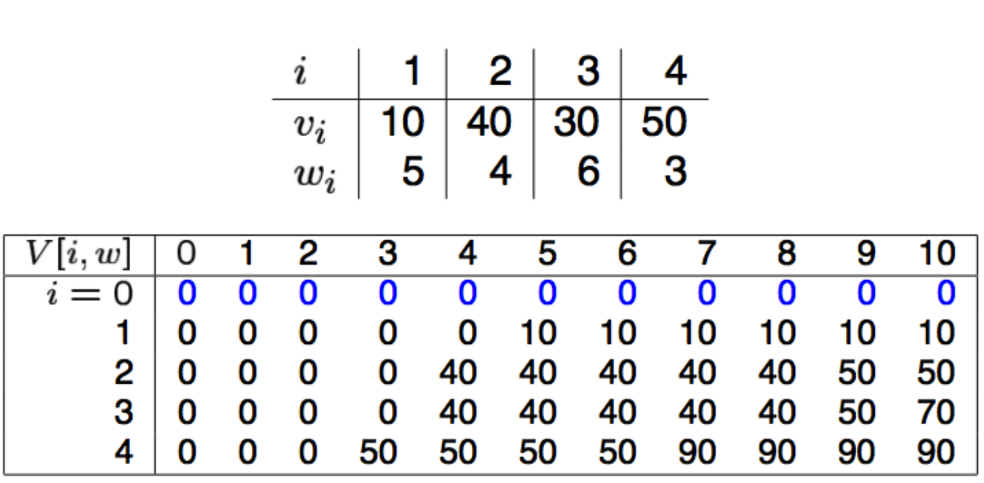

Markov Decision Process
Discounted future state distribution:
Difference in performance btw two policies
Constrained Markov Decision Processes
Augmented cost functions
Expected discounted return of policy π w.r.t. cost function Ci:
Set of feasible stationary policies for CMDP:
RL problem in CMDP:
Notes:
https://norman3.github.io/rl/docs/chapter02 : DP

Slide 5



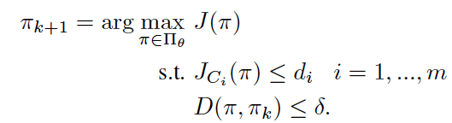
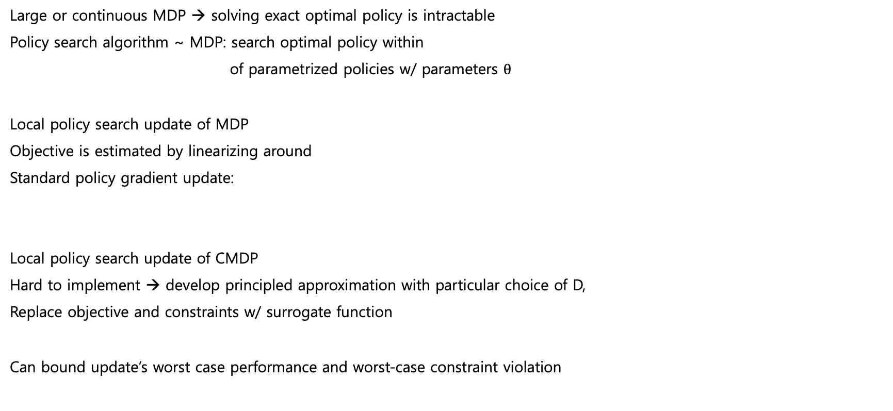



Constrained Policy Optimization
$$π_{k}$$
$$δ$$
Large or continuous MDP → solving exact optimal policy is intractable
Policy search algorithm ~ MDP: search optimal policy within
of parametrized policies w/ parameters $θ$
Local policy search update of MDP
Objective is estimated by linearizing around
Standard policy gradient update:
Local policy search update of CMDP
Hard to implement → develop principled approximation with particular choice of D,
Replace objective and constraints w/ surrogate function
Can bound update’s worst case performance and worst-case constraint violation
$$π_{k+1}$$

Slide 6
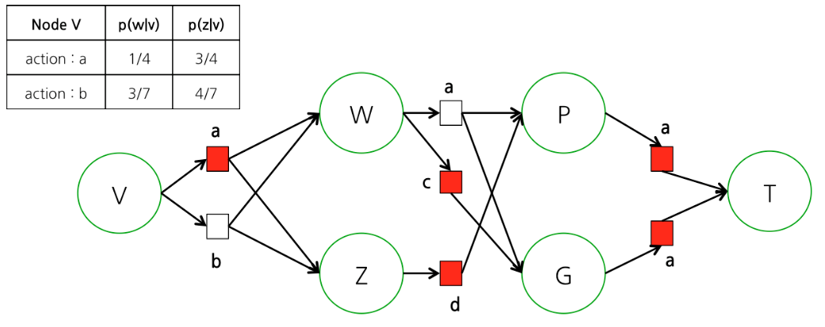
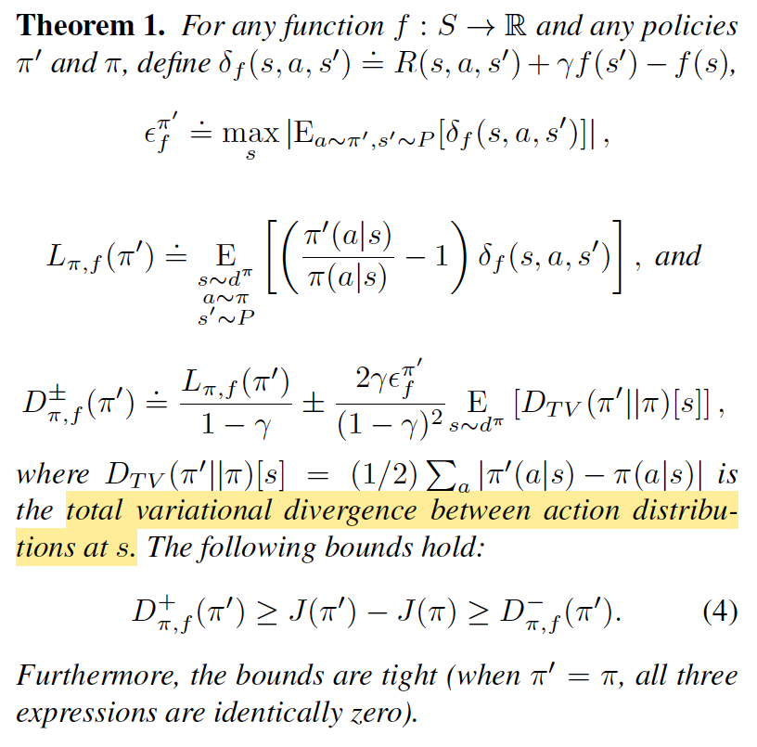
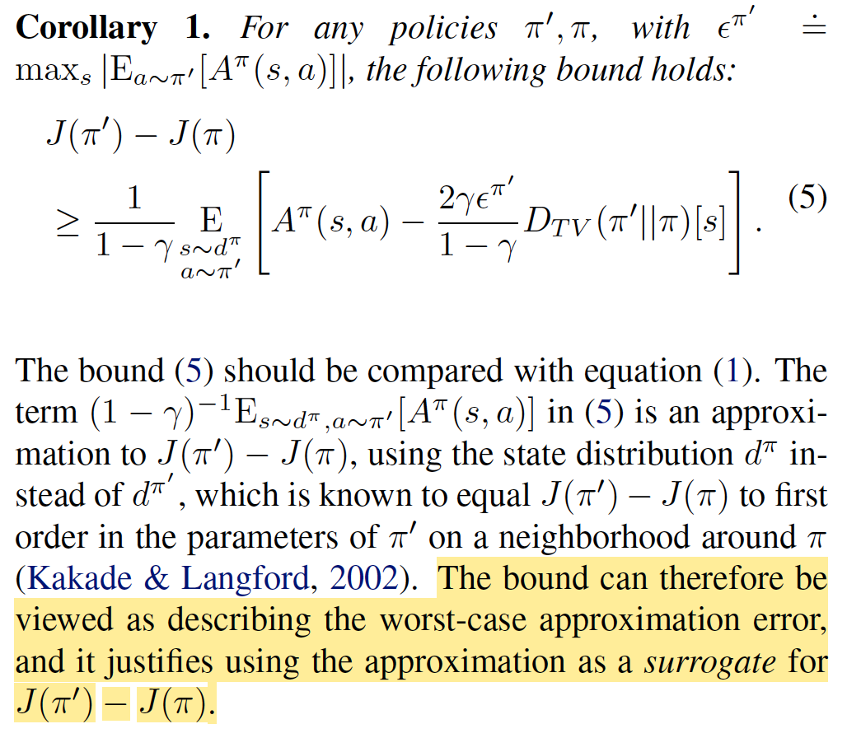
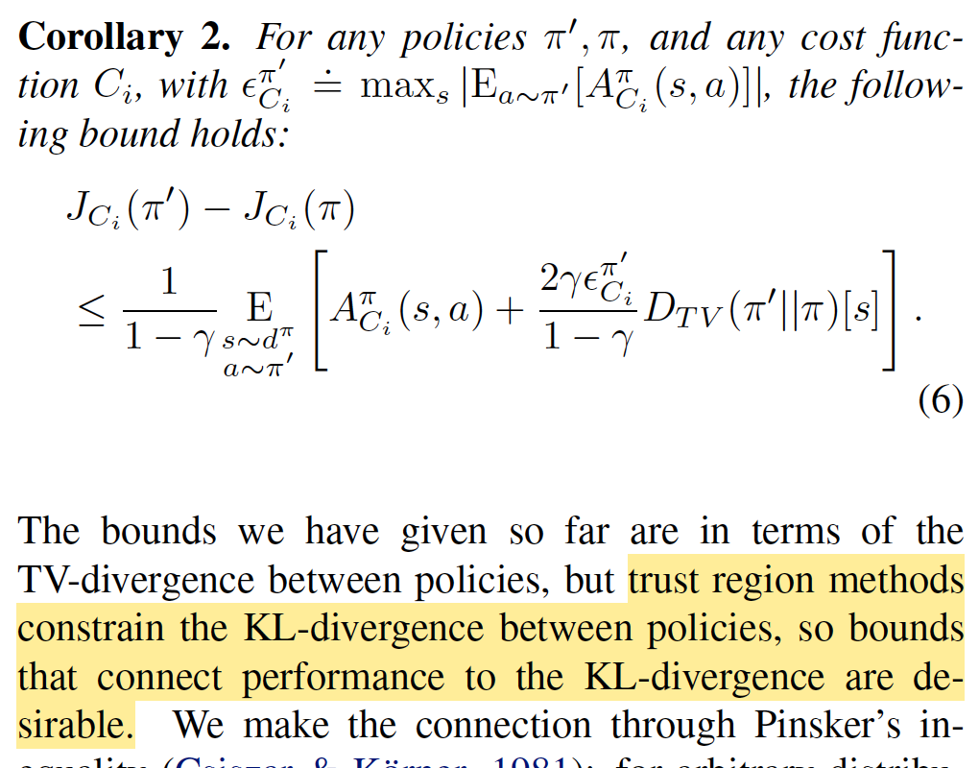
Policy Performance Bounds
s
f
s’
What prove
new bounds on the difference in returns btw two arbitrary stochastic policies in terms of an avg divergence btw them
Prove worst-case performance degradation at each update

Slide 7
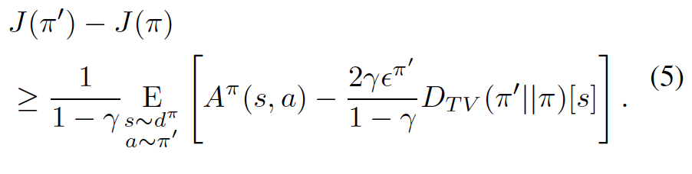
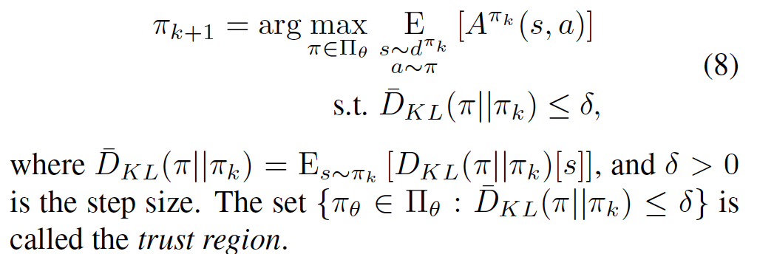
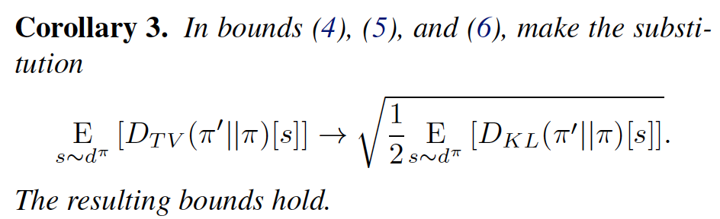
Trust Region Methods
Approximation to optimizing the lower bound on policy performance given in
Guarantee monotonic performance improvements

Slide 8
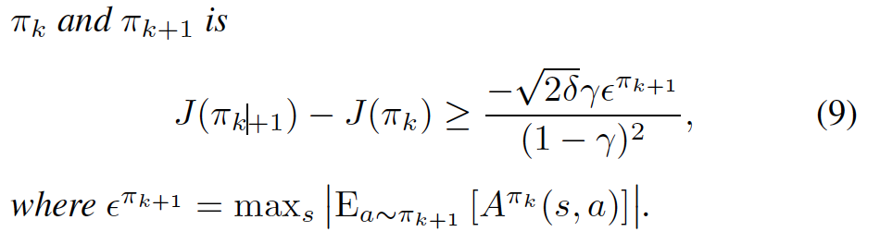
Trust Region Methods
Lower bound on the policy performance difference between
choice to develop CPO as a trust region method means that CPO inherits this performance guarantee.

Slide 9
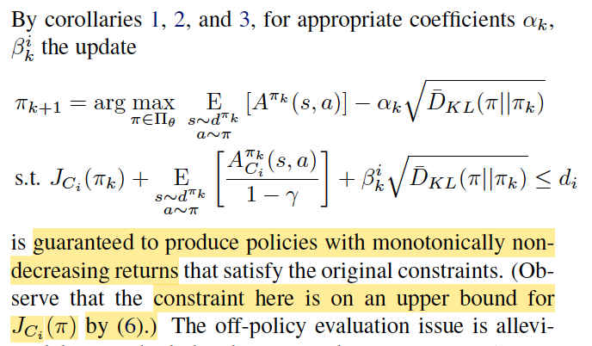
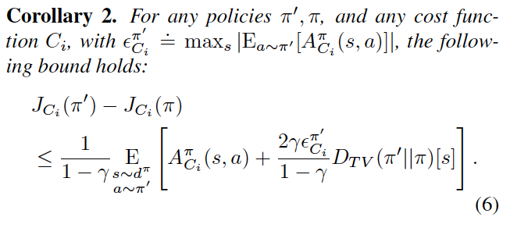
Trust Region Optimization for Constrained MDPS
1. Policy search update for CMDPs
alleviates off-policy evaluation problem
2. Guarantee of monotonic performance improvement
constraint satisfaction
3. Theoretically guaranteed update take too small step
→ CPO as a practical approximation based on trust region method

Slide 10
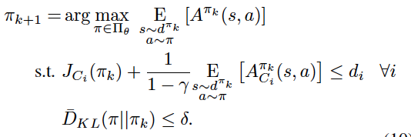
Trust Region Optimization for Constrained MDPS
In Trust region method, penalties on policy divergence are steep for discounted factors close to 1
Steps taken might be small
CPO → use trust region instead of penalties on policy divergence to enable larger step size
vs. Trust region method

Slide 11
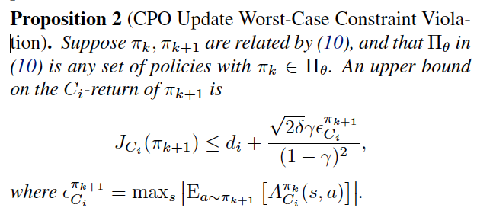
Trust Region Optimization for Constrained MDPS
CPO Update worst-case Constraint violation

Slide 12
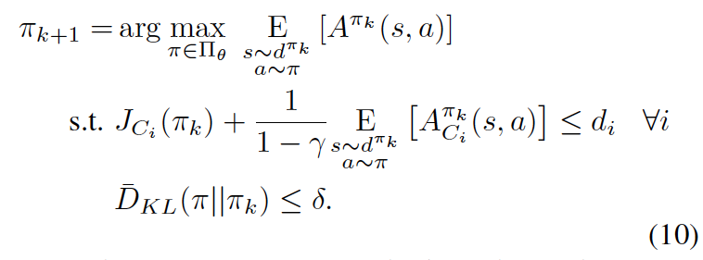
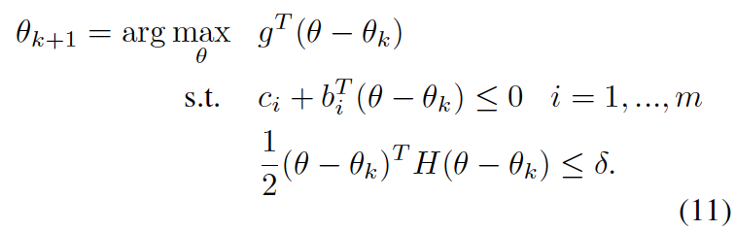

Practical Implementation
How to solve
For small step sizes $δ$, objective and cost constraints well-approximated by linearizing around $π_{k}$
KL-divergence constraint well-approximated by second order expansion
g: gradient of objective
Gradient of constraint i: $b_{i}$
Hessian of KL-divergence: H

Slide 13
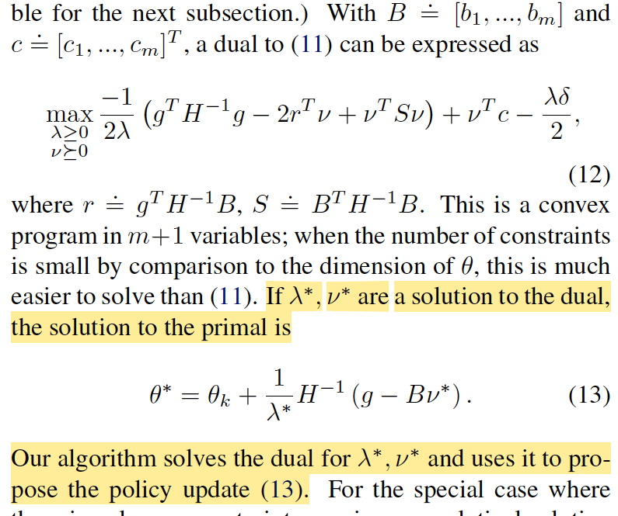
Practical Implementation
Fisher information matrix H: always positive semi-definite,
Can be solved efficiently using duality

Slide 14
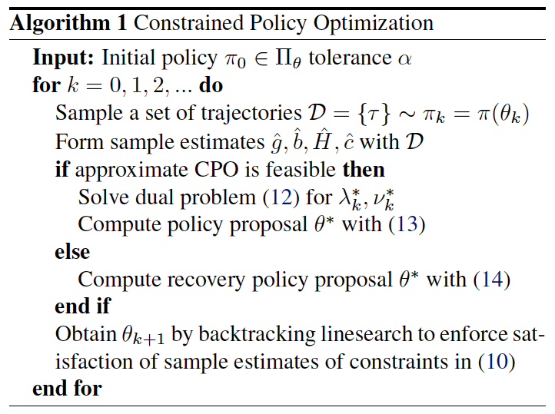
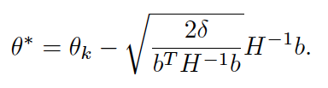

Practical Implementation
If infeasible, recovery method is necessary
→ Recover by proposing an update to purely decrease the constraint value
Constrained Policy Optimization
Various approximation
Build a factor of safety into algorithm to minimize chance of constraint violation

Slide 15
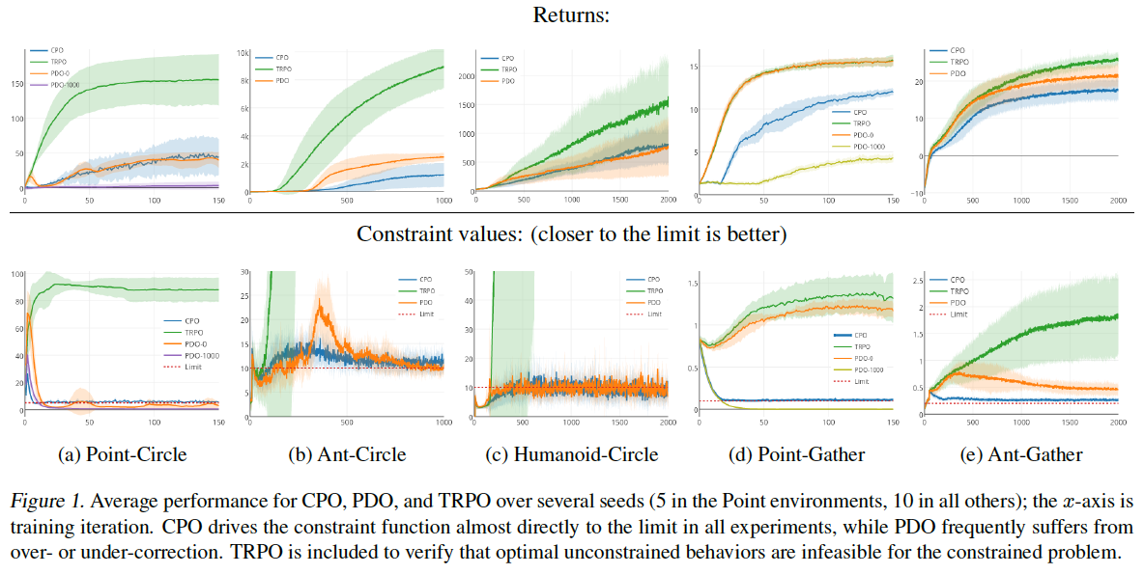
Practical Implementation
Constrained Policy Optimization

Slide 16
Questions…
Local search is enough? → maybe need some exploration
Not feasible situation then linear search… in reality?
Constrain is deterministic (step red button then penalty). In realistic, can we trust the constrain?

